Slide 1

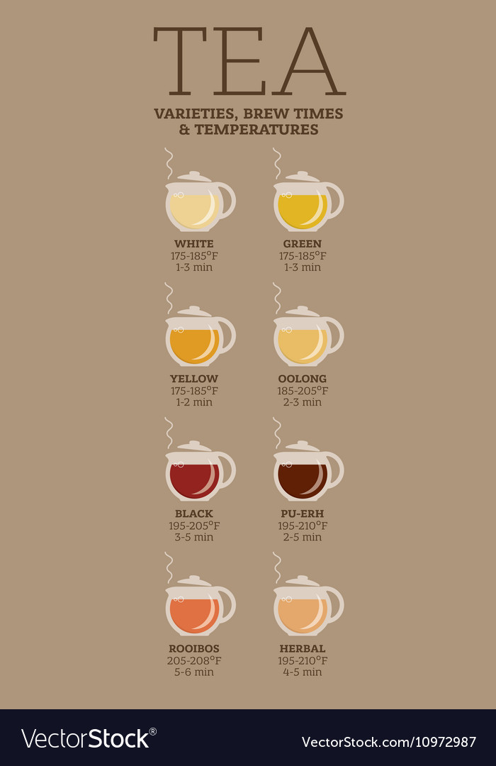
85% of British population drink tea daily¹
100 million cups daily, coffee – 70 million¹
96% - teabag¹…
specific brew time and temp. depending on tea
tea and water amount also important
¹ - FAQ's about Tea, UK Tea and Infusions Association
https://www.vectorstock.com/royalty-free-vector/tea-varieties-brewing-time-and-temperature-vector-10972987

Slide 2
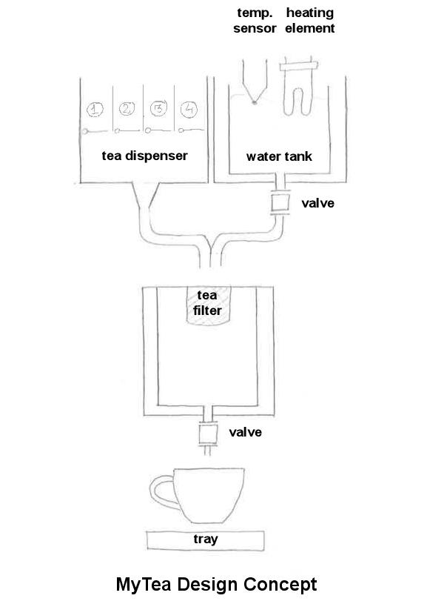
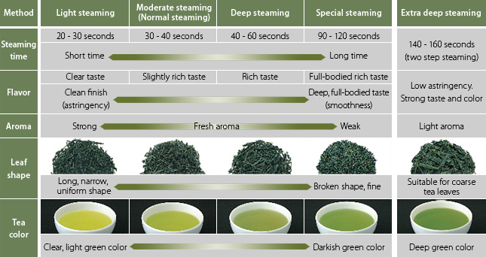
The main idea:
controls water temperature
pours exact amount of water
dispenses exact amount of tea chosen
brews and dispenses tea
Potential extras:
http://www.itoen-global.com/allabout_greentea/production_processing.html

